Slide 1
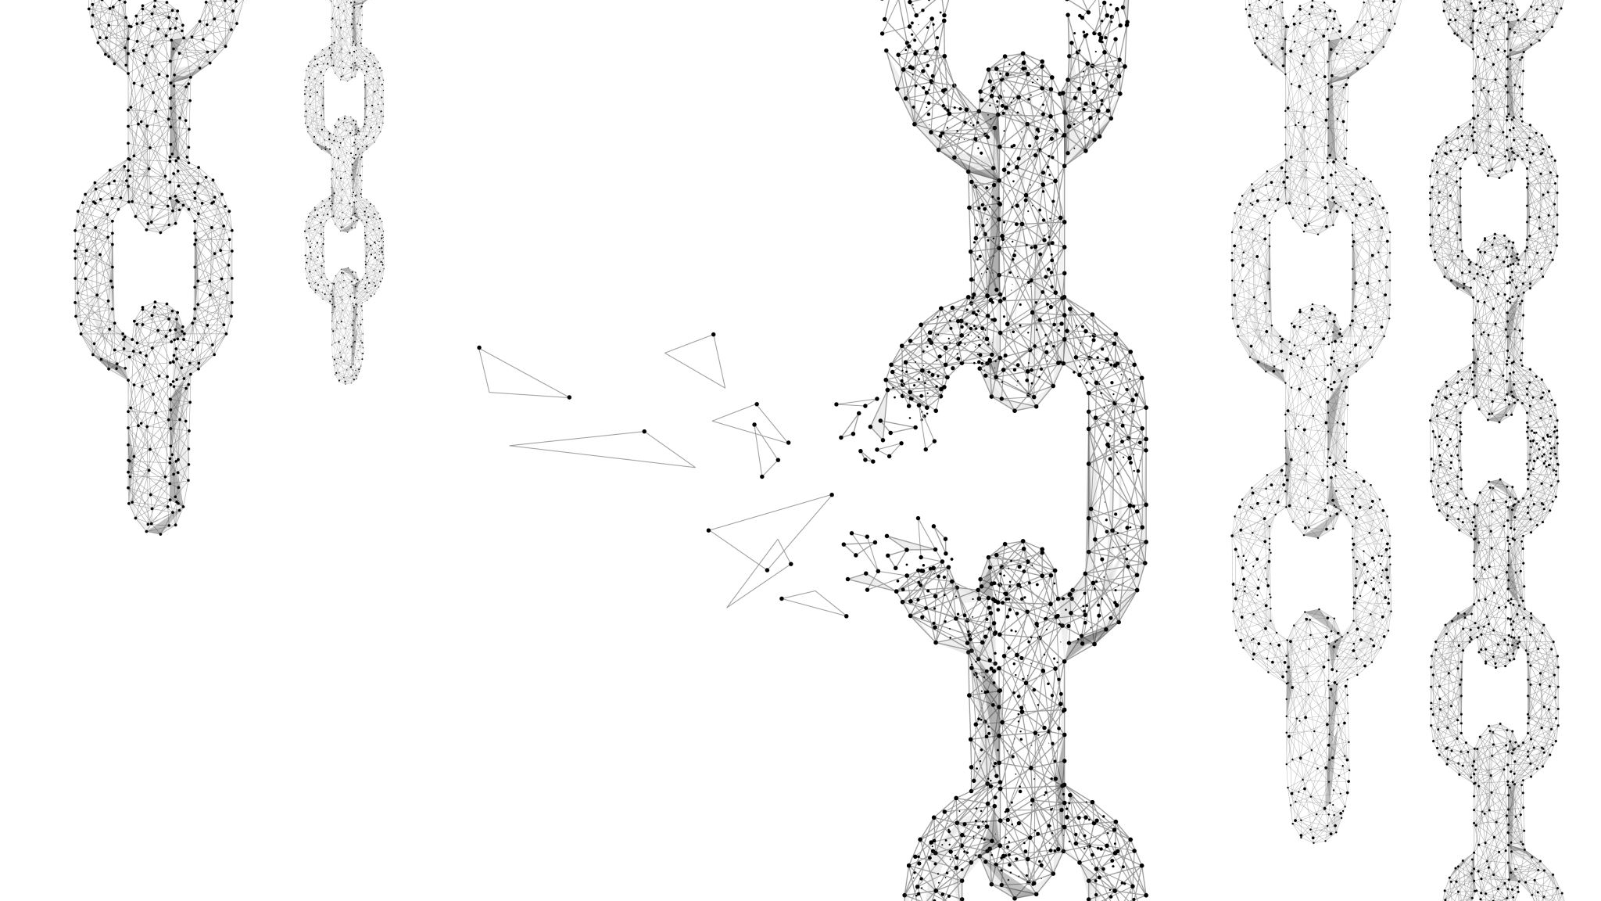
Blockchain-Based Application Design and Development
Dharmesh Chaudhary (z5379826)
Amos Li Sheng Tan (z5440950)
Oden Petersen (z5220271)
Praseem Singh Beniwal (z5268220)

Slide 2
Domain and Challenges
Domain - Food supply chain
Food supply chains are complex and globalized, requiring reliable solutions.
COVID-19 and geopolitical conflicts have highlighted the need for secure and trustworthy supply chains.
Traditional software solutions lack transparency and may be limited to specific languages or jurisdictions.
Blockchain technology offers immutability, transparency, and trust in recording transactions.
Automation of payments reduces counterparty risk for suppliers.
Integration with existing software systems allows for efficient supply chain management.
Challenges Faced
Data Security & Integrity: Blockchain ensures tamper-resistant and transparent records, preventing data alteration or disputes.
Speed in Transaction: Blockchain technology speeds up transactions in the chosen domain, reducing processing time from days to seconds.
Data Loss: Decentralization in blockchain minimizes the risk of data loss by distributing it across multiple nodes.
Certification and Compliance: Blockchain simplifies certification processes, allowing authorities to record and validate certifications, enhancing trust and transparency.
Notes:
Domain – Food supply chain
Agricultural supply chains have become increasingly complex and globalised, and have suffered a lot during COVID and as a result of geopolitical conflicts in the past couple years. Being an essential part of the global economy, it’s important to ensure their reliability and integrity.
International transactions of large amounts of money or goods require immutability, transparency, and trustworthiness in the keeping of receipts and other records. Non-blockchain software solutions for record-keeping and information sharing fail to adequately address these business requirements, and may be overly specific to a particular language or legal jurisdiction. Furthermore, the automation of payments may help to protect suppliers from counterparty risk.
Finally, a blockchain with smart contract capabilities could also help to automate business processes associated with supply chain management through integration with ordinary off-chain software, e.g. an Enterprise Resource Planning (ERP) system.
Challenges Faced
Data Security & Integrity: Blockchain ensures tamper-resistant and transparent records, preventing data alteration or disputes.
Speed in Transaction: Blockchain technology speeds up transactions in the chosen domain, reducing processing time from days to seconds.
Data Loss: Decentralization in blockchain minimizes the risk of data loss by distributing it across multiple nodes.
Certification and Compliance: Blockchain simplifies certification processes, allowing authorities to record and validate certifications, enhancing trust and transparency.

Slide 3
Feedback Improvement
More explained Functional and Non-Functional requirements
No use of an API due to a lack of single authority in a public blockchain
Reduced emphasis on identity verification to have a clearer scope.
Using Ethereum with Python3.

Slide 4
Functional Requirements
Receipt Signing and order verification – Both sides of the supply chain can sign receipts and verify order details using our smart contracts
Inventory Management – Suppliers can put order listings according to their inventory. Furthermore, each order placed updates the inventory list to avoid over-ordering.
Historical Look-up – All intermediate and final receipts are recorded on the blockchain and hence can be tracked. Also, consumers can track their order status from intermediate receipts.
Payment Verification – Off-chain payments are verified on-chain by the bank.
Off-chain heavy processing – To allow orders to be processed faster all routing from supplier to consumer is kept off-chain.
Notes:
Functional
Receipt Signing: Users should be able to publish receipts signed by both parties certifying a delivery of goods or money at a specific time
Inventory Management: Users should be able to manage and update their inventory levels, as well as adding listings for new products
Historical Look-up: See previous transactions, receipts, etc. and verify their authenticity
Non-functional
Interoperability: The supply chain system should have the ability to integrate and interact with other widely used systems or components within the supply chain ecosystem (e.g., ERP, shipment tracking systems, banking), and adhere to agreed-upon industry standards for record-keeping.
Compliance: The system should adhere to relevant legal/regulatory requirements, e.g., data privacy, labeling, certification standards, record-keeping.
Performance and Scalability: The system should be able to maintain acceptably low transaction latency and cost (e.g., gas cost), even for records involving many different counterparties (e.g., from different stops in the journey of a shipment).

Slide 5
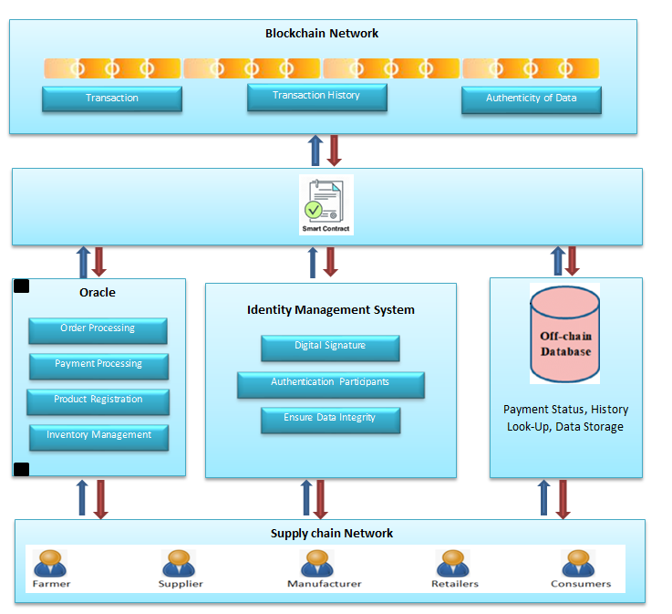
Architecture
Public
Permissionless
Oracle(s) based

Slide 6
Implementation
Smart Contract 1 – Order
Product
Owner (consumer)
Seller
Shipper
verifiedBySeller
verifiedByShipper
Current Delivery Point
Last Updated Time
Deliver Points (addresses and point names)
Delivery Due Times
Smart Contract 2 – Product
Store Keeping unit (stock management)
Seller
Product Name
Price / per unit
Price Decimals (for accurate pricing)
Quantity Available
Product Description
Oracle – Off-Chain
Payment status of the order
Seller to consumer routing through intermediaries

Slide 7

Product Demo and Code Walkthrough

Slide 8
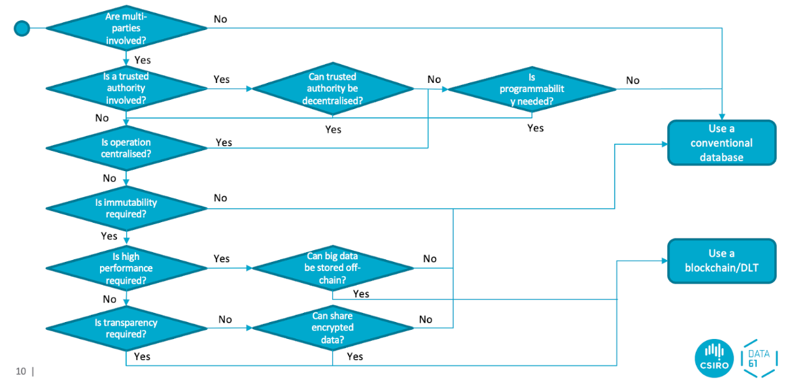
Blockchain Suitability
Questions | Answers
Multi-party Interactions | Yes (Manufacturer, Shipping, Client)
Centralized operations | No
Data Immutability | Yes
Data Transparency | Yes
Confidentiality | Yes
Performance | Maybe (average wait of 10-15 min)
Scalability | Yes (<= 200,000 users)
Notes:
Is there a need for multi-party interactions?
Manufacturer, Shipping, Client
• Are operations centralised?
No
• Is data immutability required?
Yes
• Is data transparency required for effective/fair operations in the domain?
Yes
Future/promise transactions - agreement for delivery with specific terms
• Are there any private data, Personally Identifiable Information (PII), or is confidentiality
required commercially?
Yes, but probably solvable
• Is high performance and scalability required?
≤200,000 users
Not super critical, maybe 10-15min wait is acceptable at peak usage times

Slide 9
Development Plan
Week | Plan
Week 6 | Conduct research on Oracle. Define the scope of the problem and clear project objectives.
Week 7 | Review research findings as a group. Create a detailed project plan and assign tasks. Begin implementing the skeleton of the system.
Week 8 | Develop individual modules or functions. Establish a testing framework with initial test stubs. Aim to set up the Oracle database and connect it to the system.
Week 9 | Follow test-driven development principles. Prepare for the project demonstration.
Week 10 | Reflect on the project and gather feedback. Make final changes and refinements. Practice the project presentation.

Slide 10

Thank You
Any Questions?

